Slide 1

Brew Crew
David Jimenez, David Alberghini, John Mowry, Joey Riebel, Spencer Davis, & Bailey Taber

Slide 2
Our Motivation
As a team of curious beer lovers - we wanted to get ahead of the data and identify the influencing factors behind a brewery launch. Breweries have become more and more prevalent in the United States. Living in, Colorado, a brewery hub, we’ve formed some experienced and educated speculations.
Notes:
Read Slide
*are our hypothesis’

Slide 3

Brew Crew Project Proposal
Questions
How have beer sales and the number of breweries in the US changed over time?
Does a county's total population, age or median income have a strong correlation to the number of breweries in the county?
Which demographic has the strongest influence on the number of breweries in a county?
Resources
Alcohol and Tobacco Tax and Trade Bureau CSVs
GitHub Open Brewery DB CSVs
US Capital Latitude and Longitude CSV
United States Census Bureau API
Open Weather API
GMAPS

Slide 4
Analyzing Data...

Slide 5
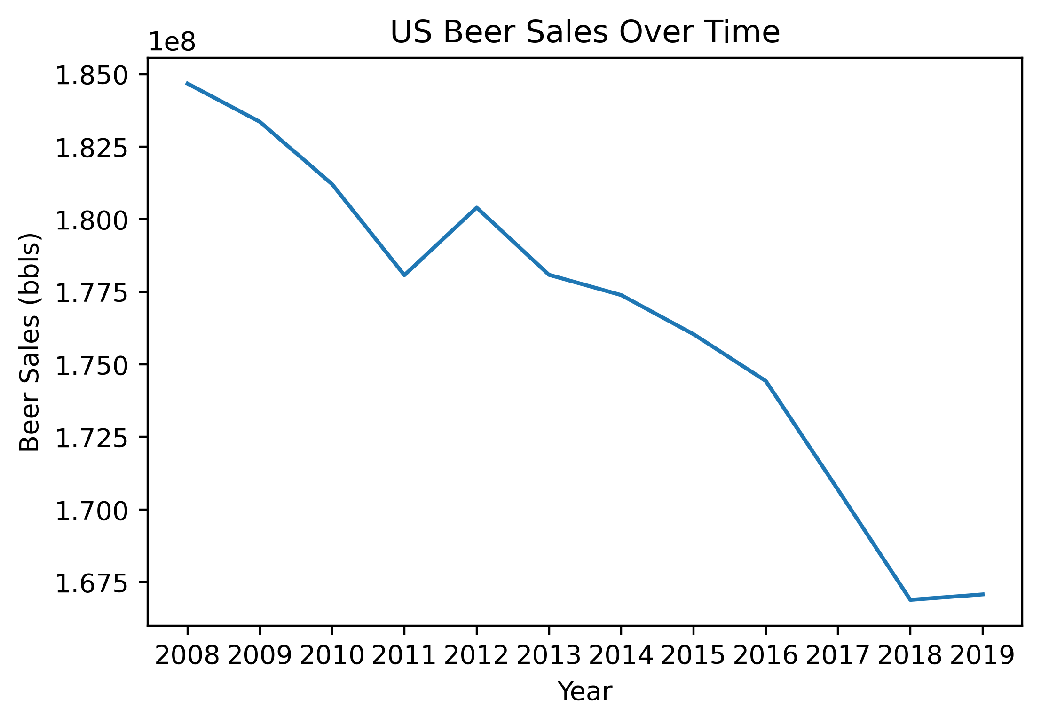
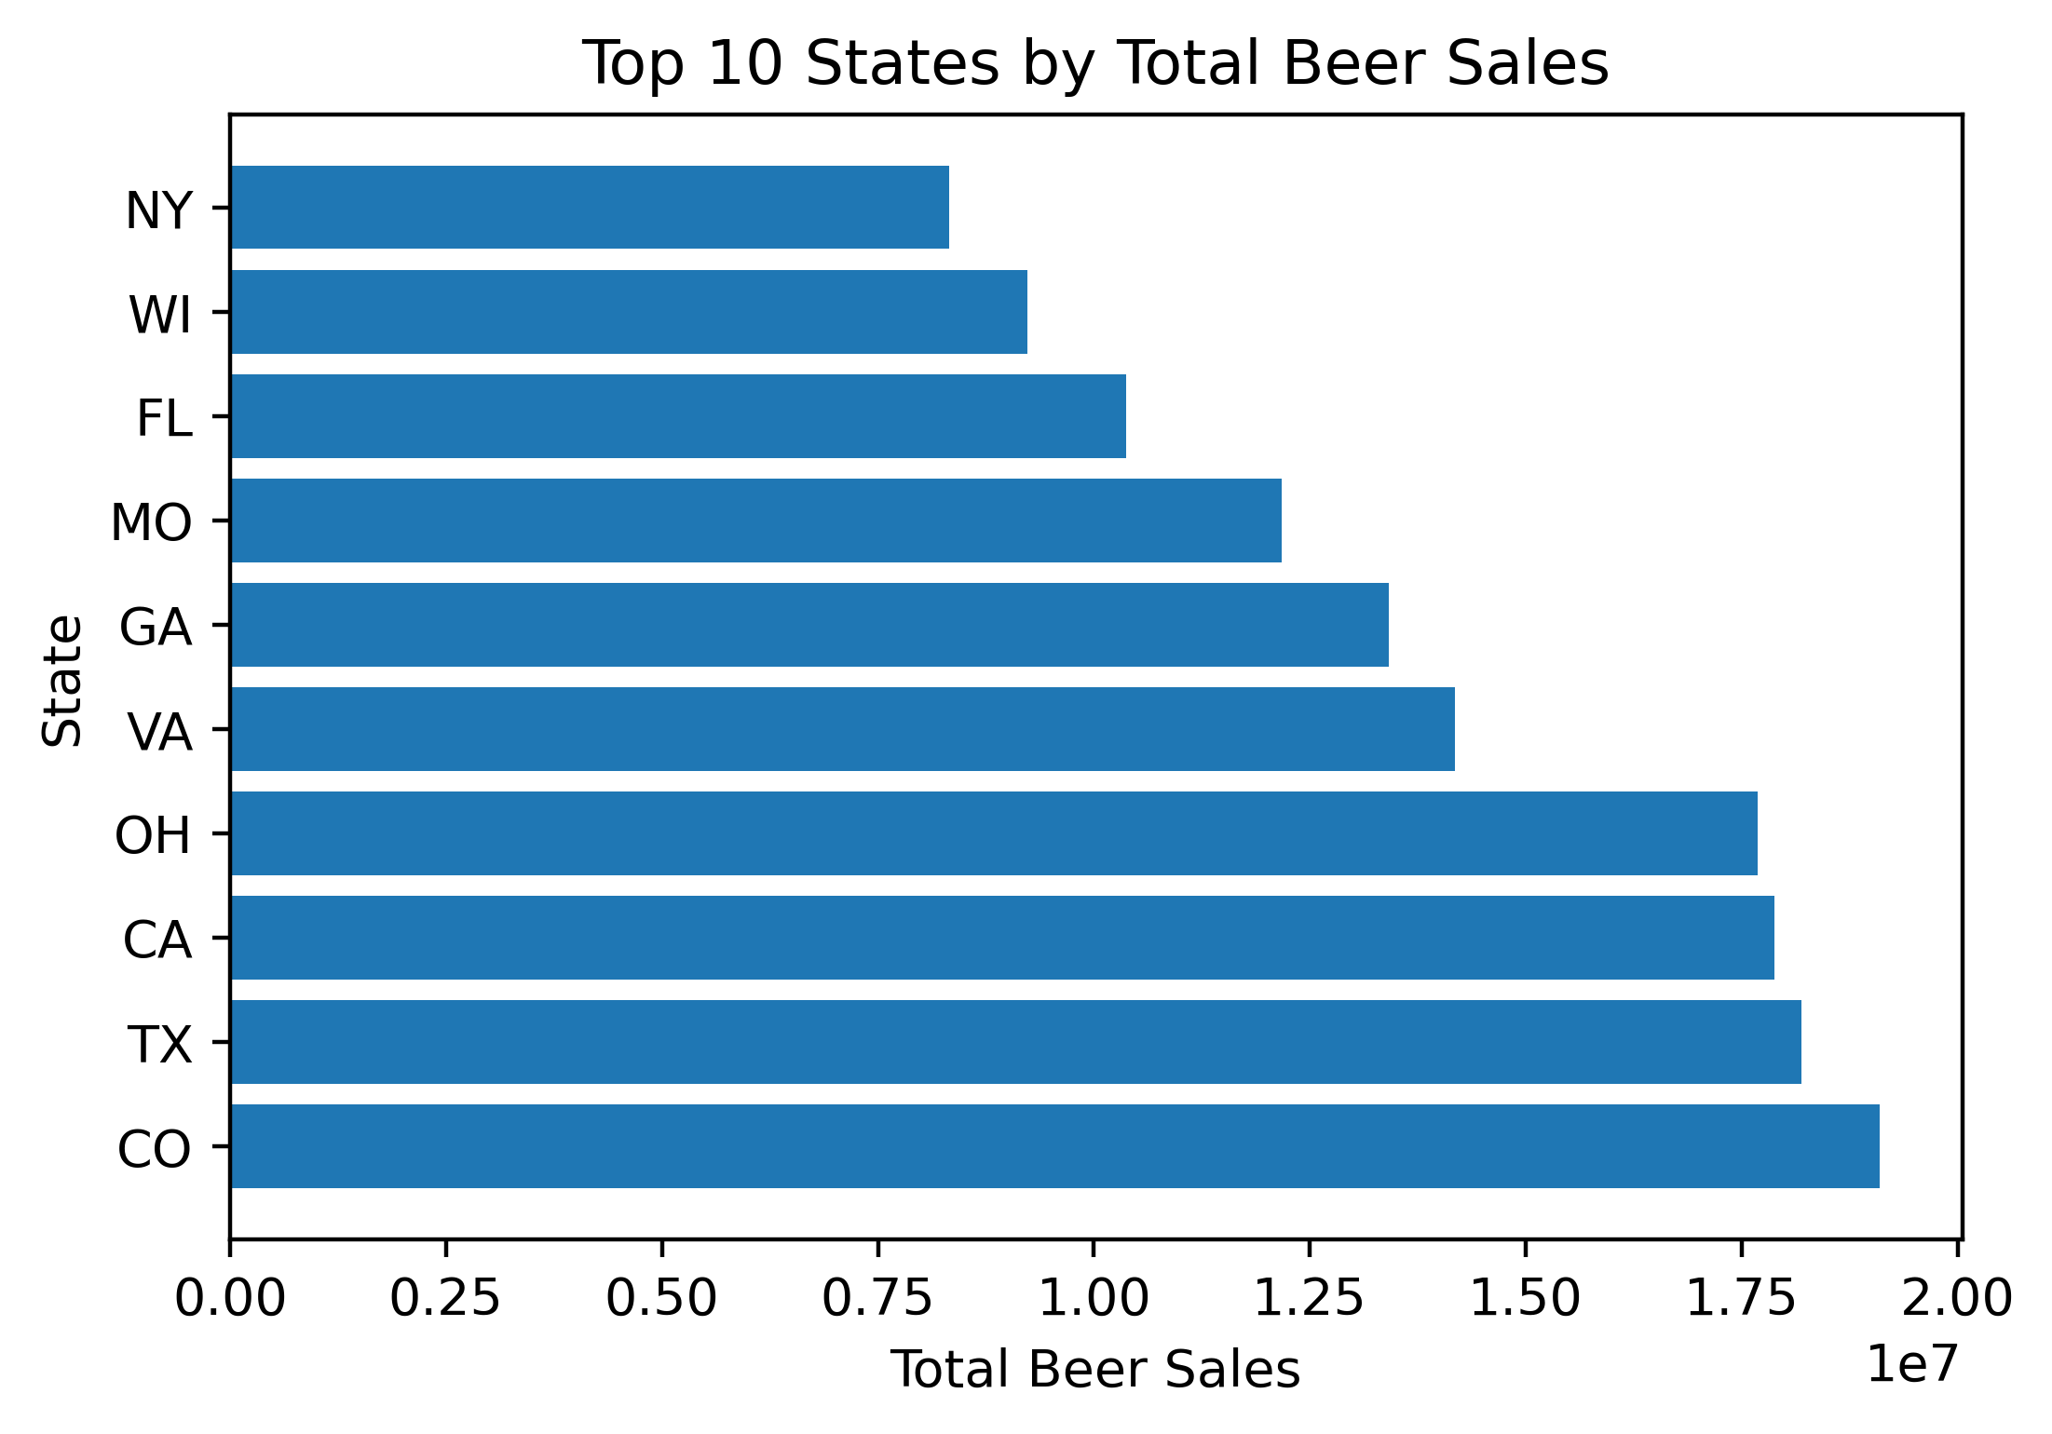
Beer Sales Overview
Nearly a 10% decrease in taxable beer sales between 2008 and 2019

Slide 6
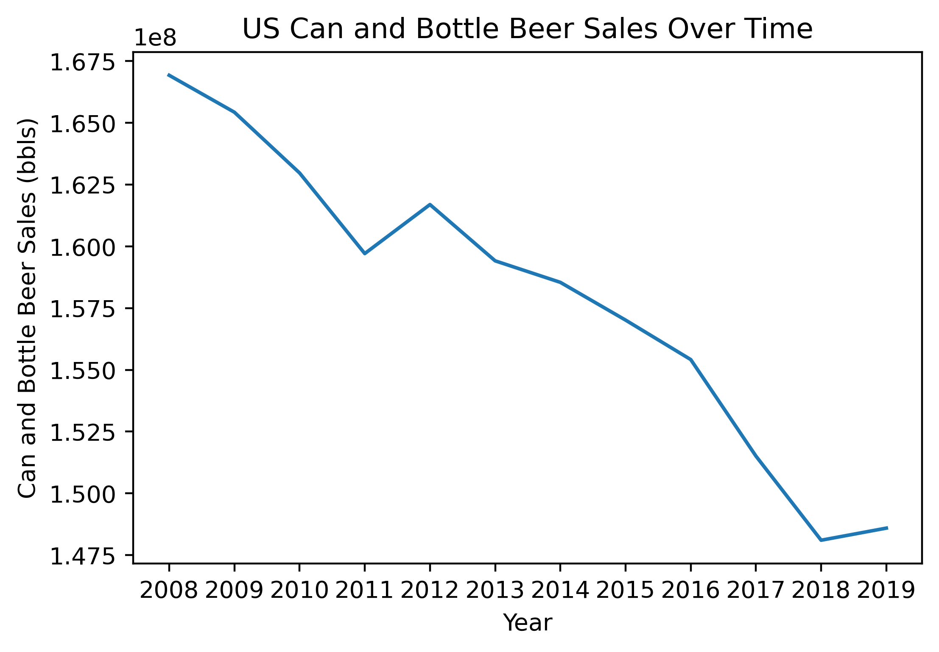
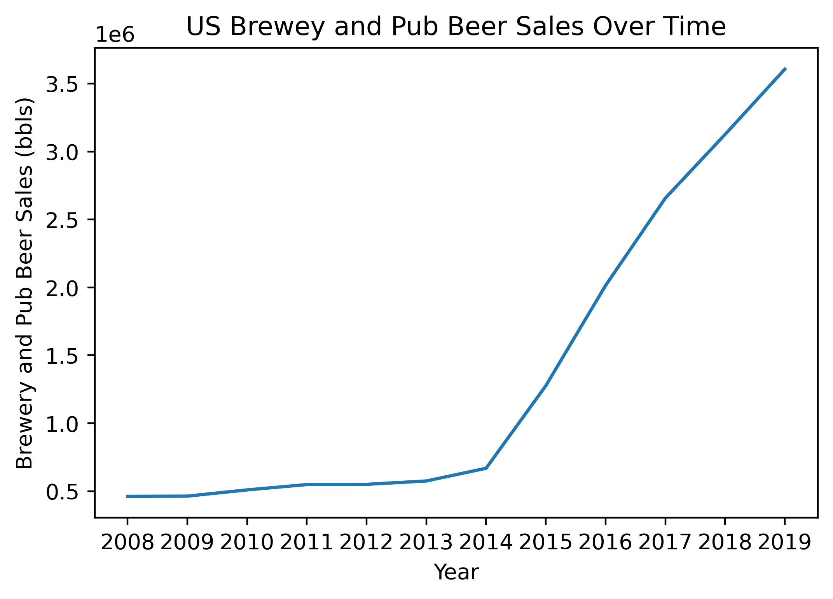
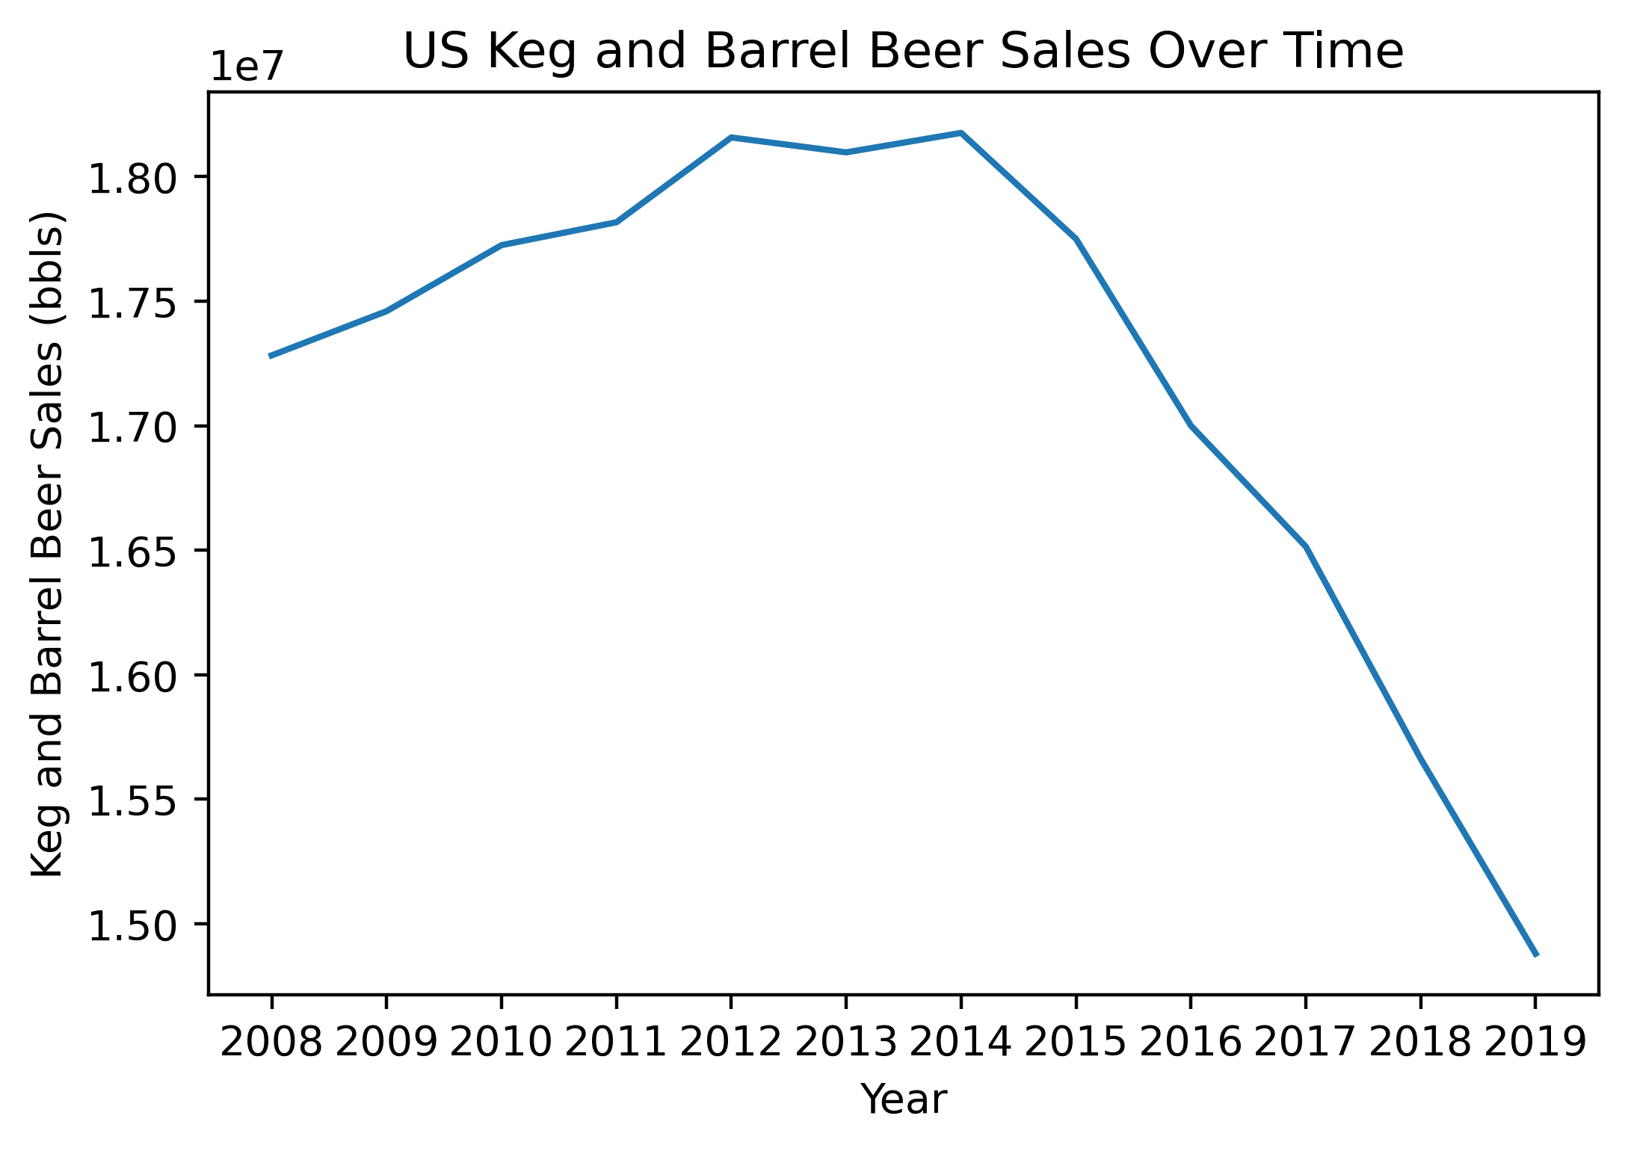
Beer Sales Overview
Brewery and Pub beer sales quadrupled between 2014 and 2019

Slide 7
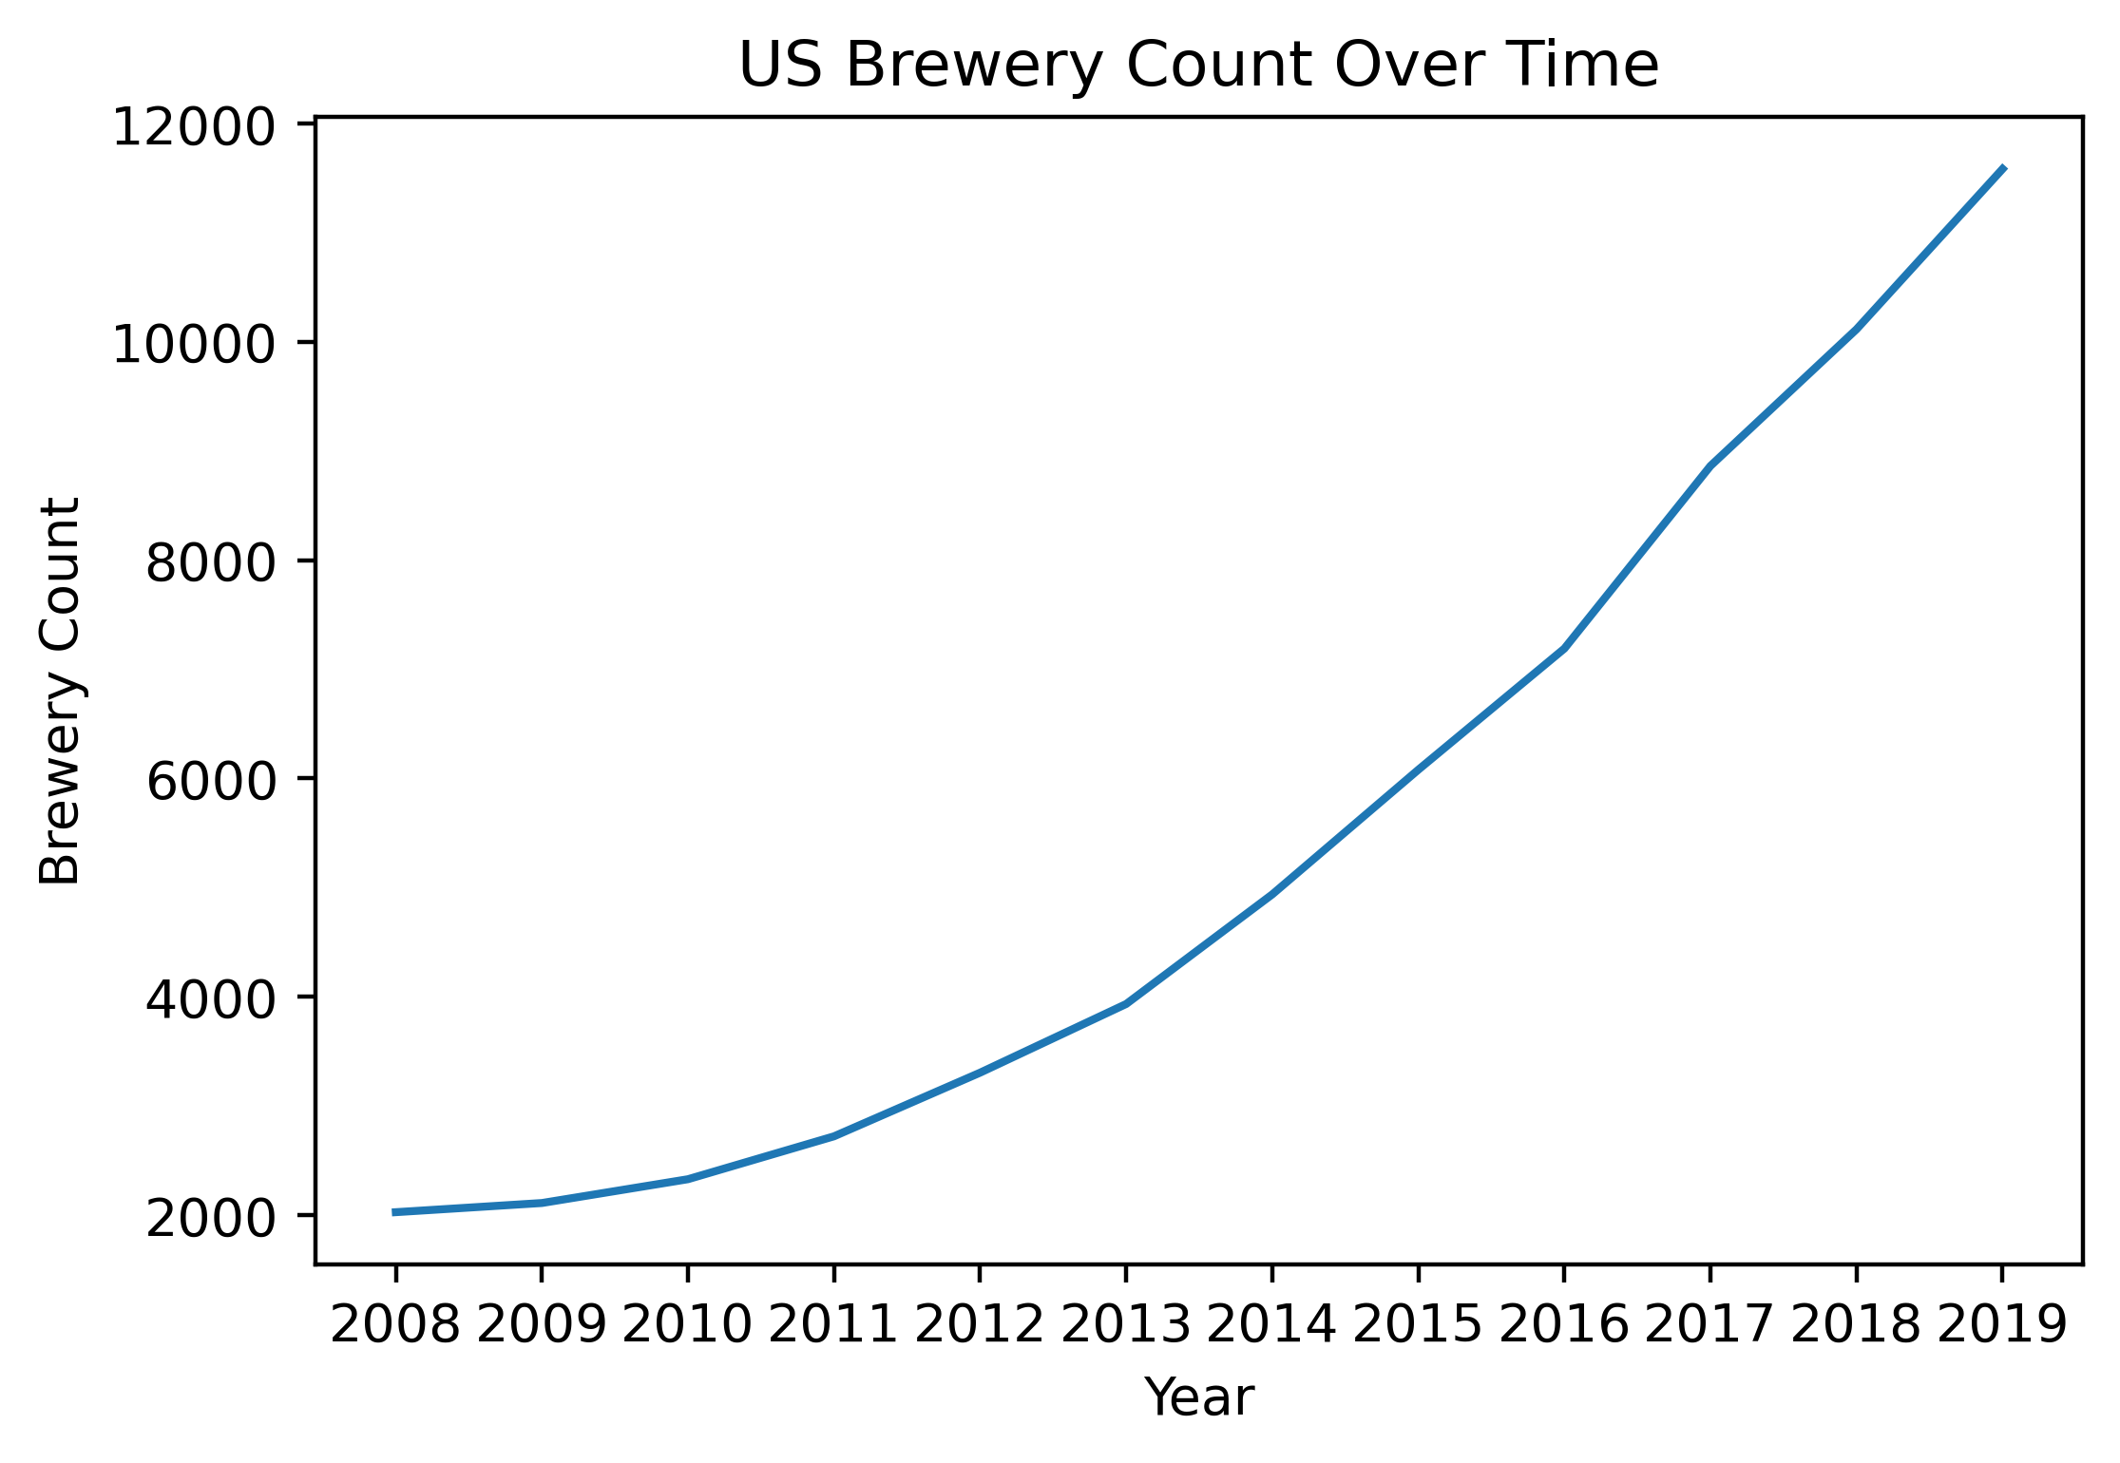
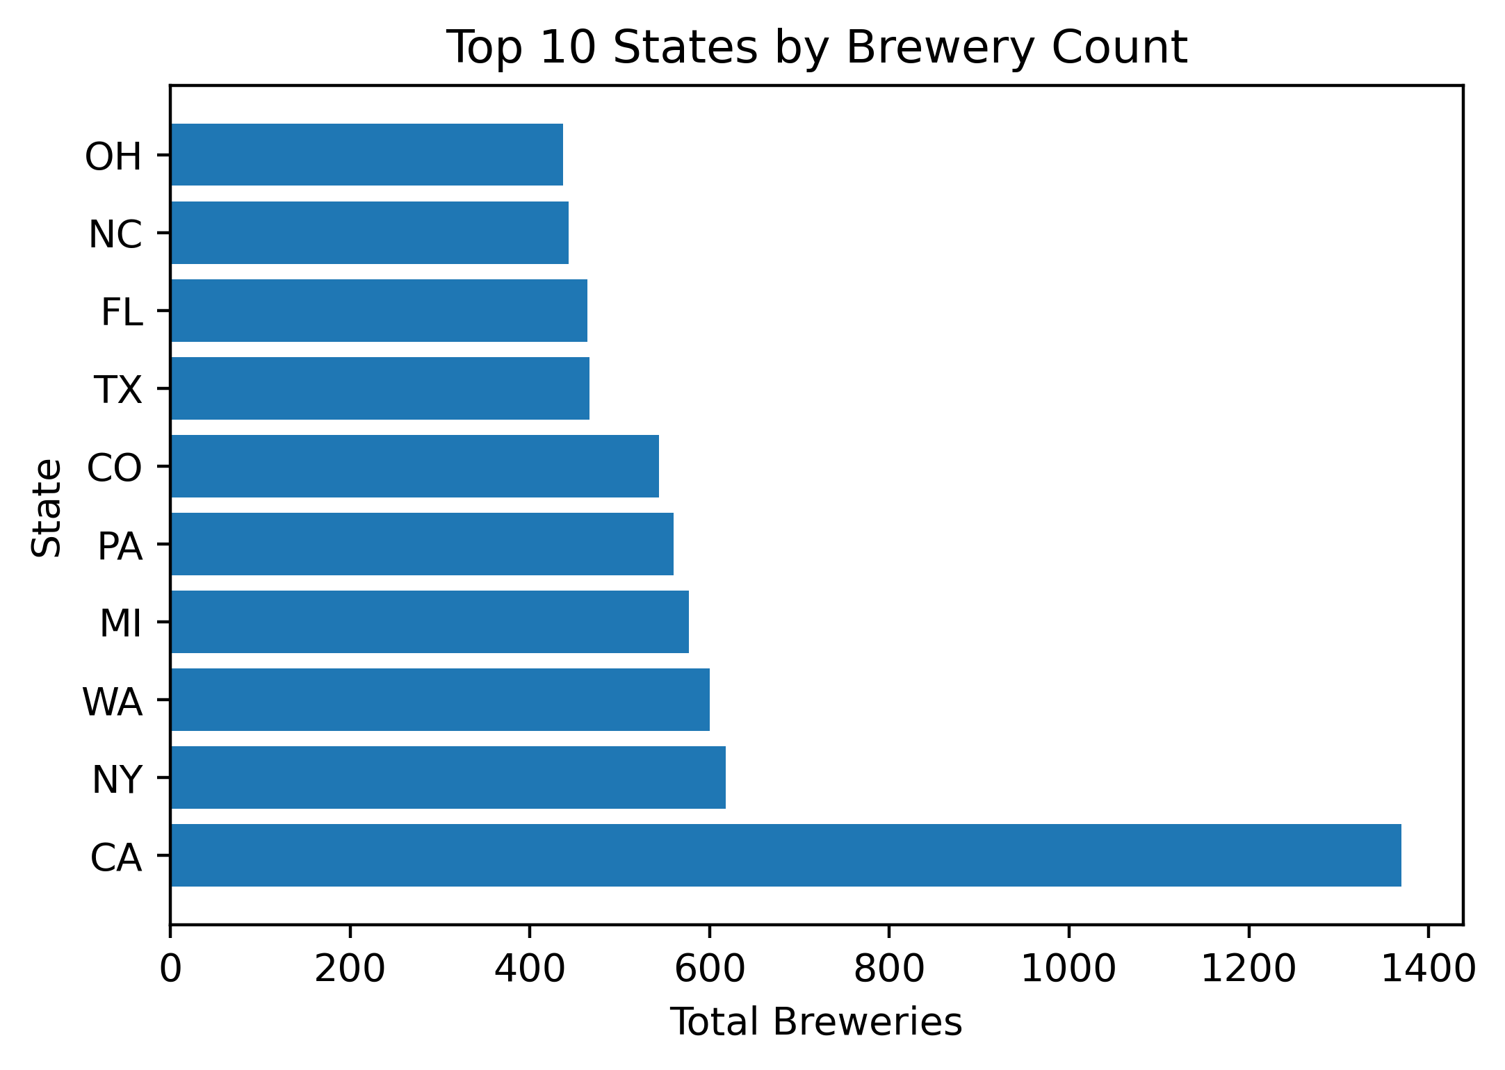
Brewery Count Overview
Between 20018 and 2019, brewery counts have shown a near exponential growth pattern.
With the brewery count in 2019 being nearly 6x that of 2008

Slide 8
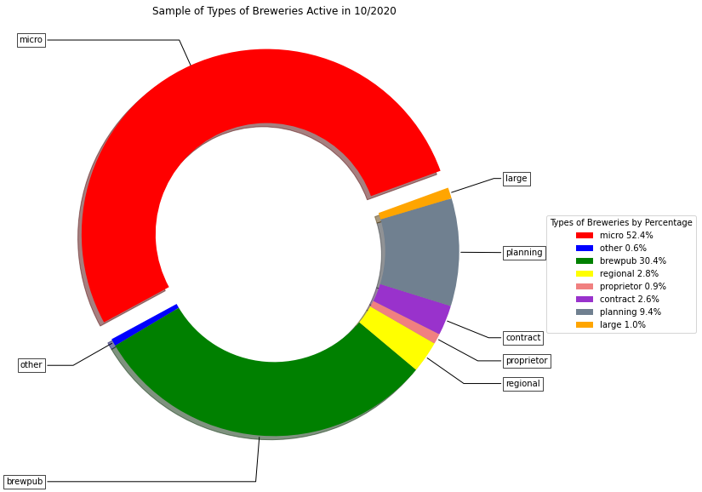
Brewery Type
Micro Breweries are the most popular type in our sample population.

Slide 9
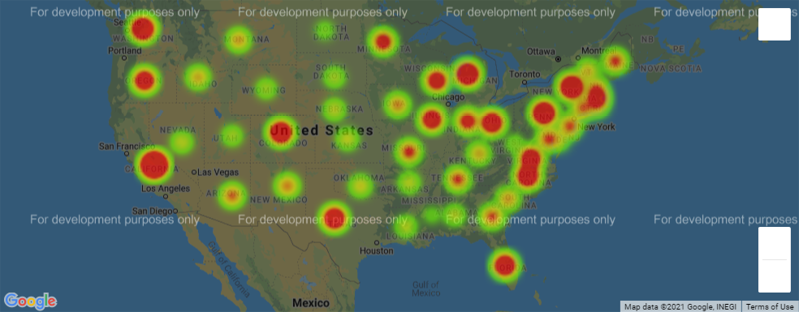
Heat map of Total Licensed Breweries by State Capital
Notes:
Heat map of brewery counts centered around us state capitals

Slide 10
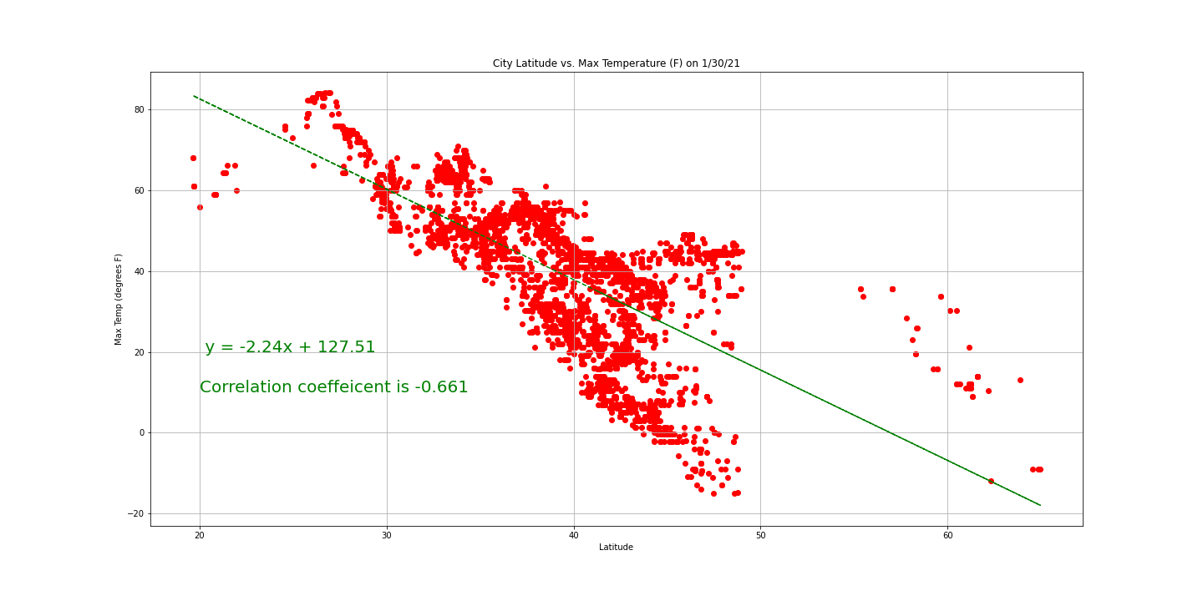
Max Temperature vs. Brewery Latitude
There appears to be a slight correlation between colder temperatures and more breweries.

Slide 11
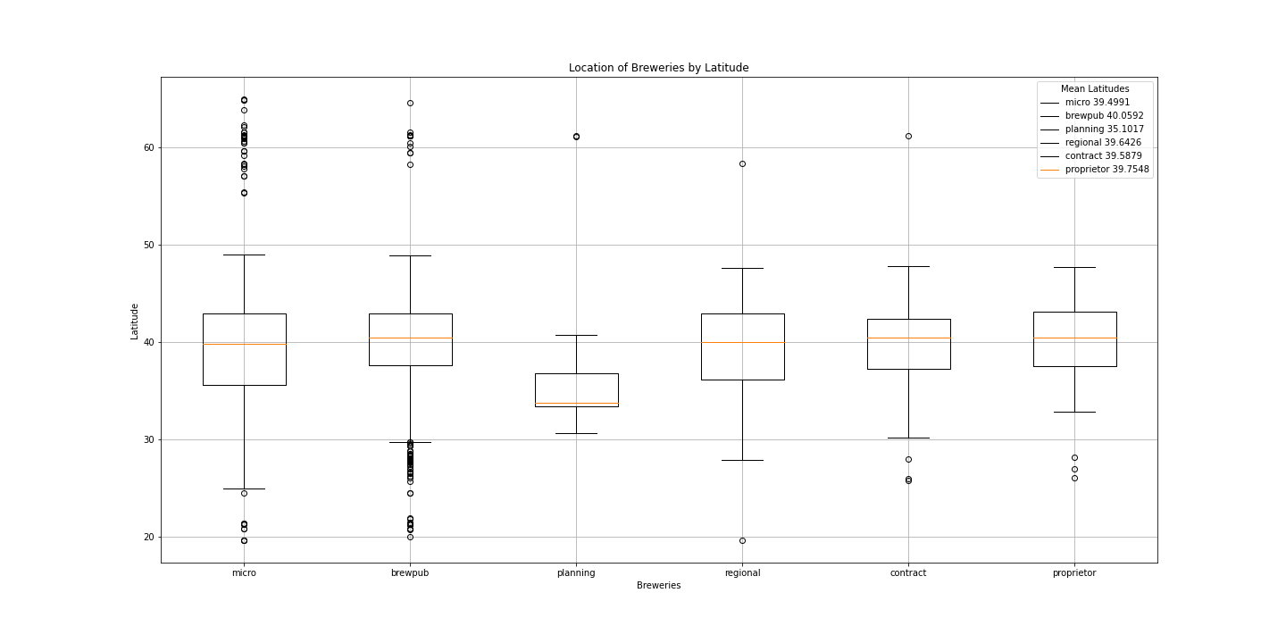
Latitude Findings

Slide 12
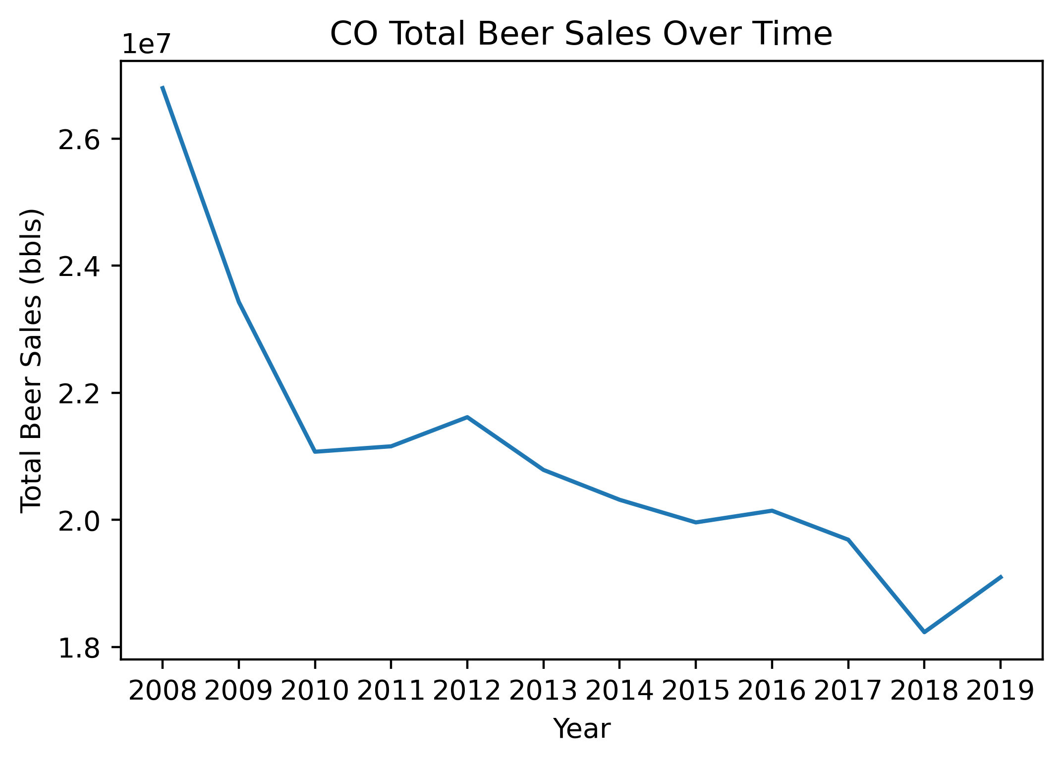
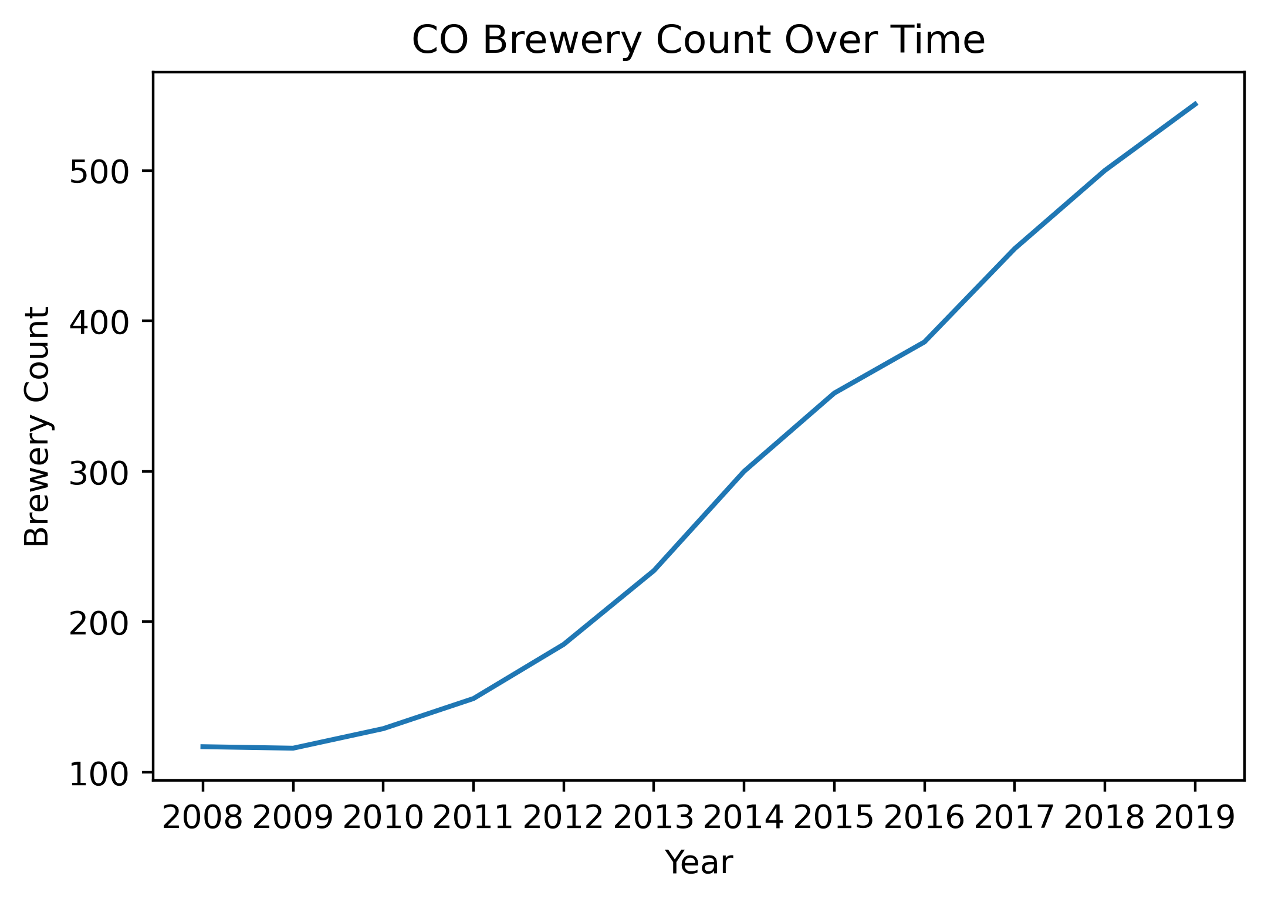
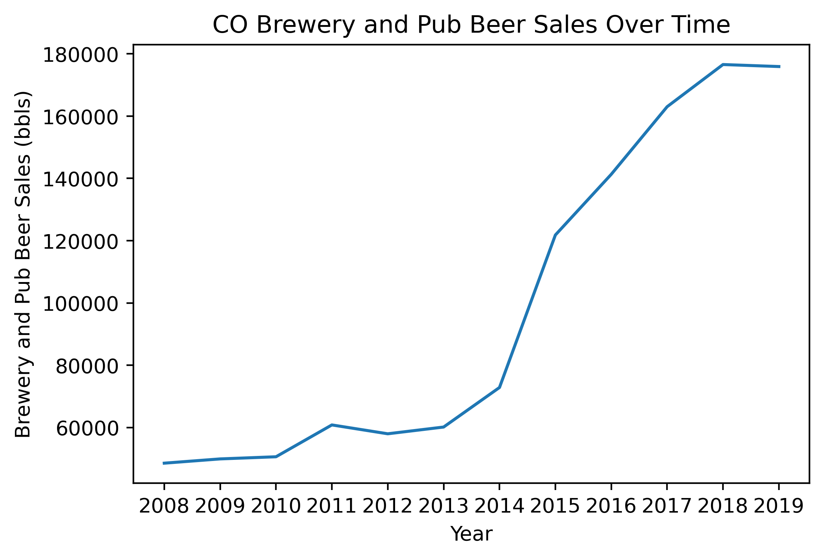
Colorado Data Set

Slide 13
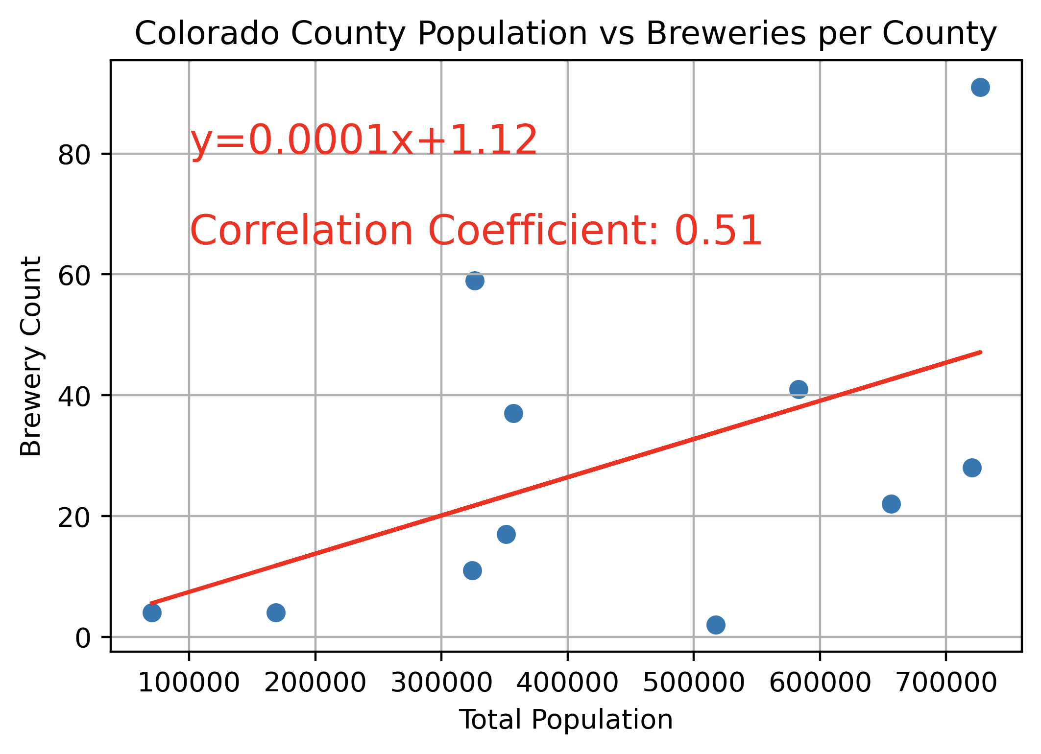
Brewery Count and Population
There appears to be a weak correlation between a counties brewery count and total population within the sample dataset.
After breaking down the population by gender, similar results were found.

Slide 14
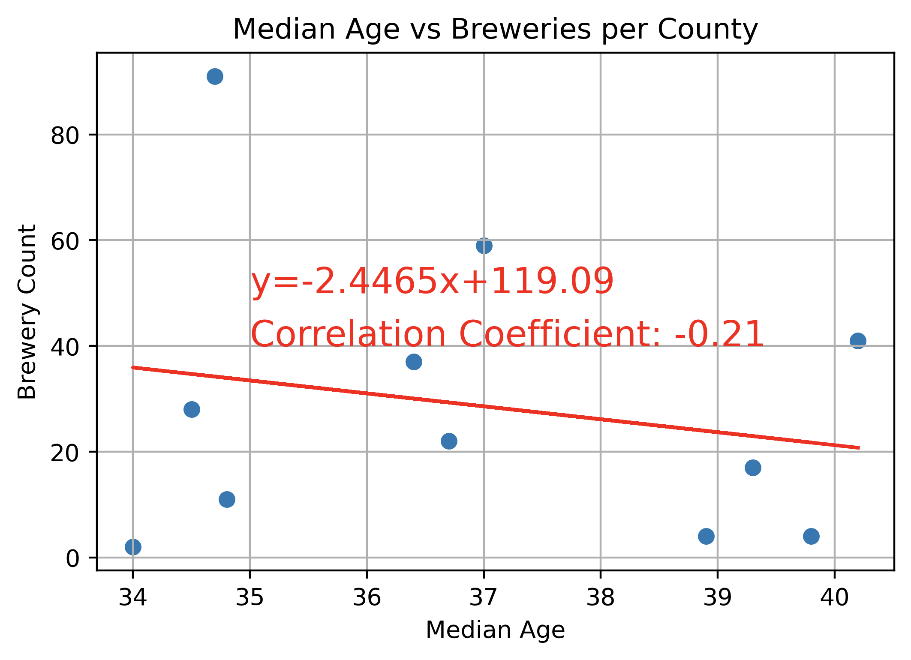
Brewery Count and Median Age
There does not appear to be a strong correlation between a counties brewery count and the median age.
Notes:
Joey

Slide 15
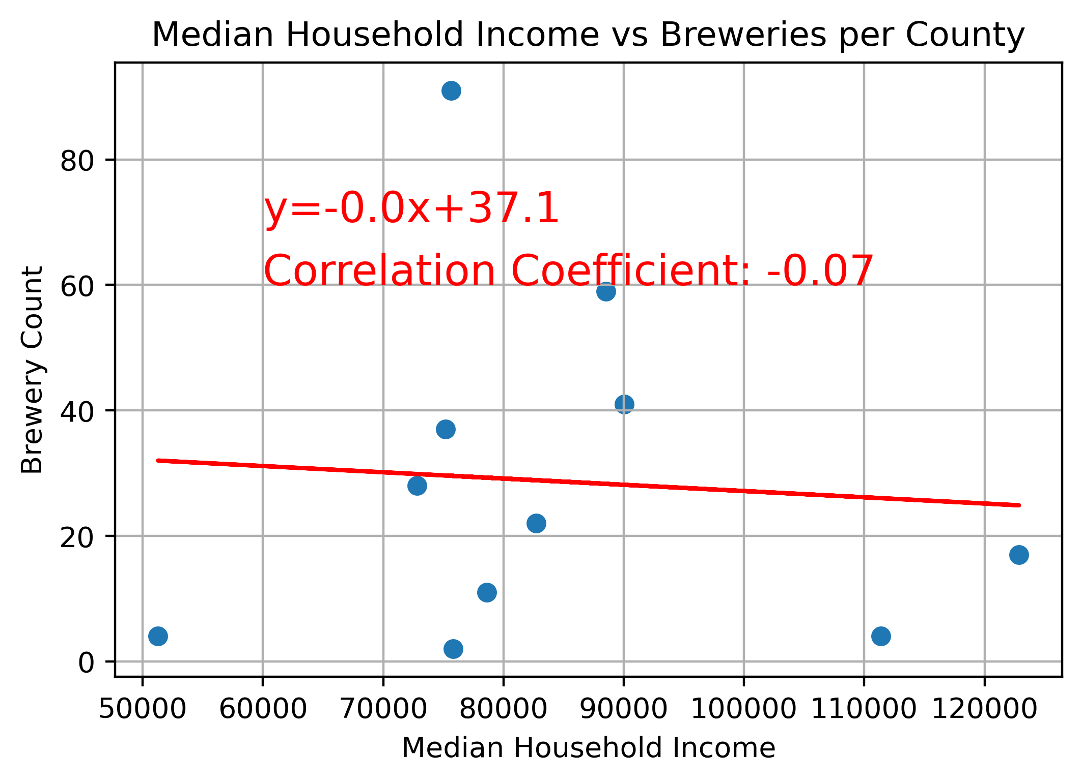
Brewery Count and Median Income
There does not appear to be a strong correlation between a counties brewery count and the median income.
Notes:
Joey

Slide 16
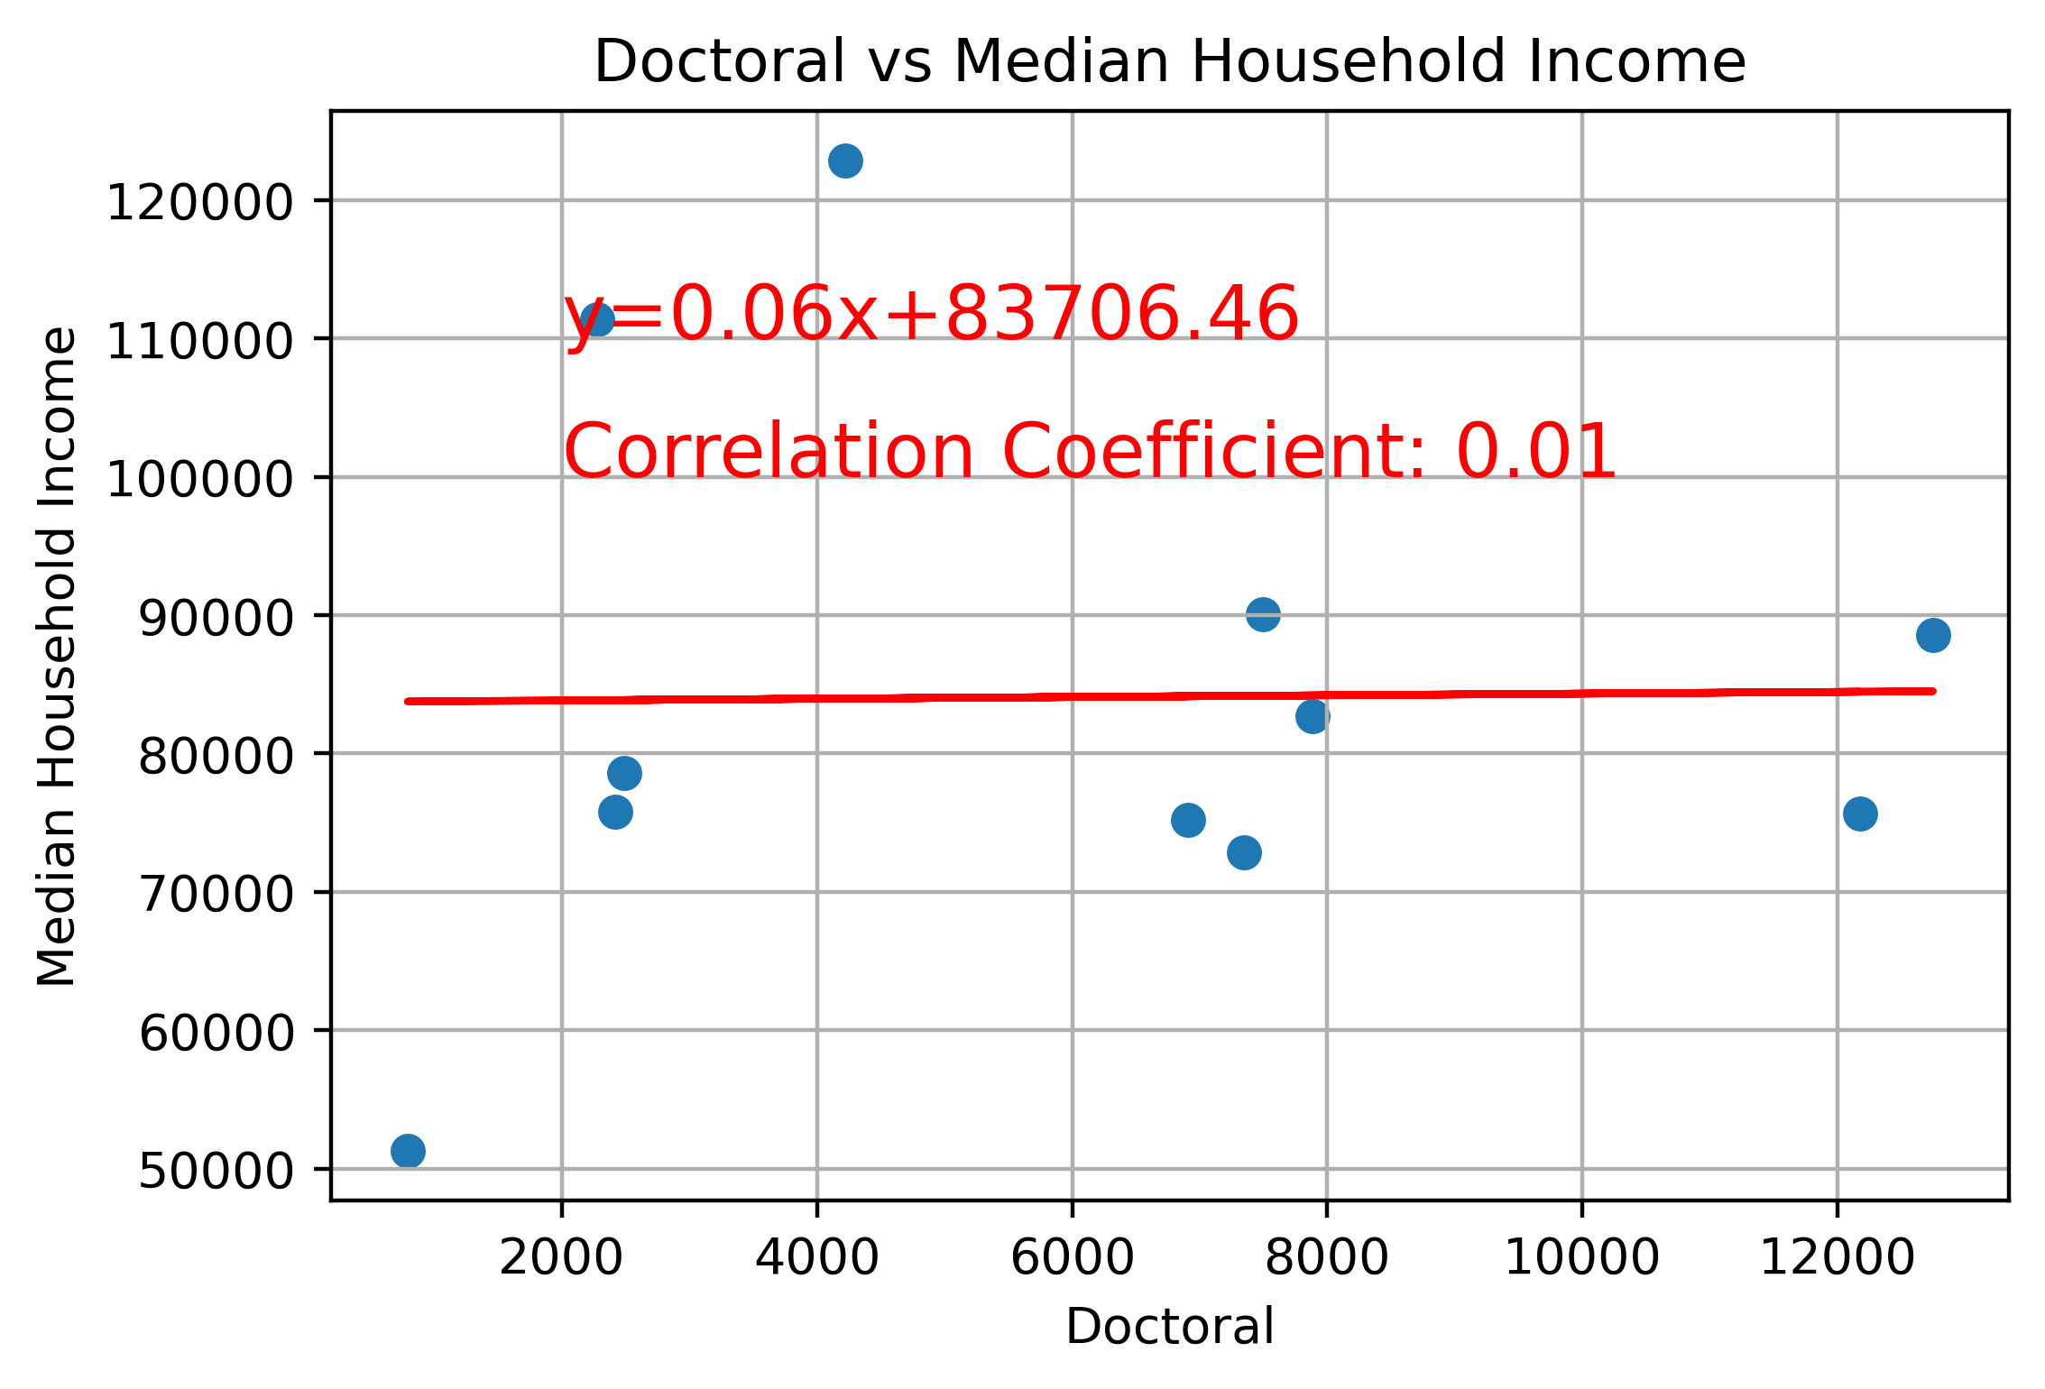
Median Household Income and Higher Education
There does not appear to be a correlation between a counties median household income and the total number of residents with a PhD.
Notes:
John

Slide 17
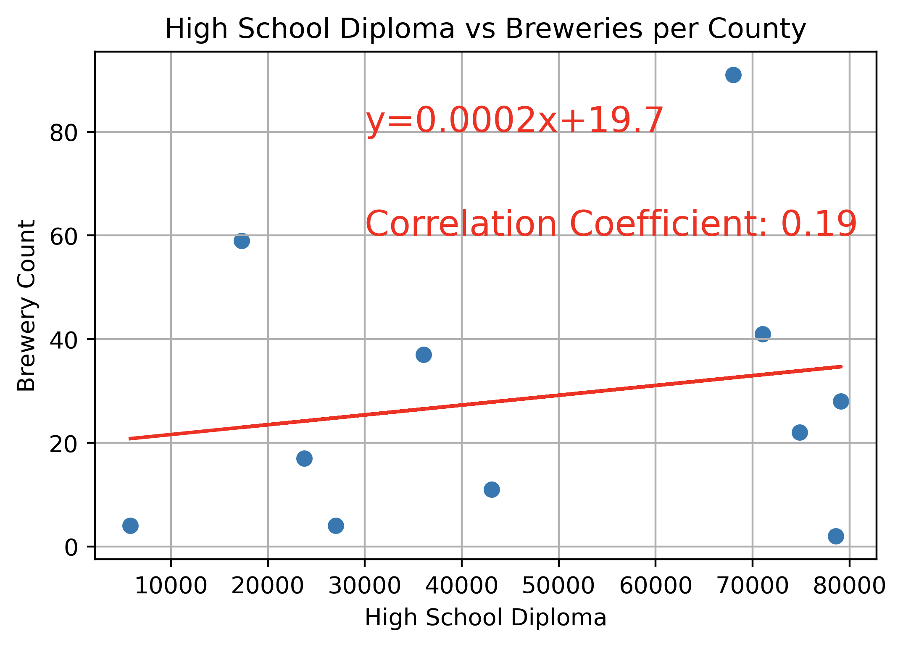
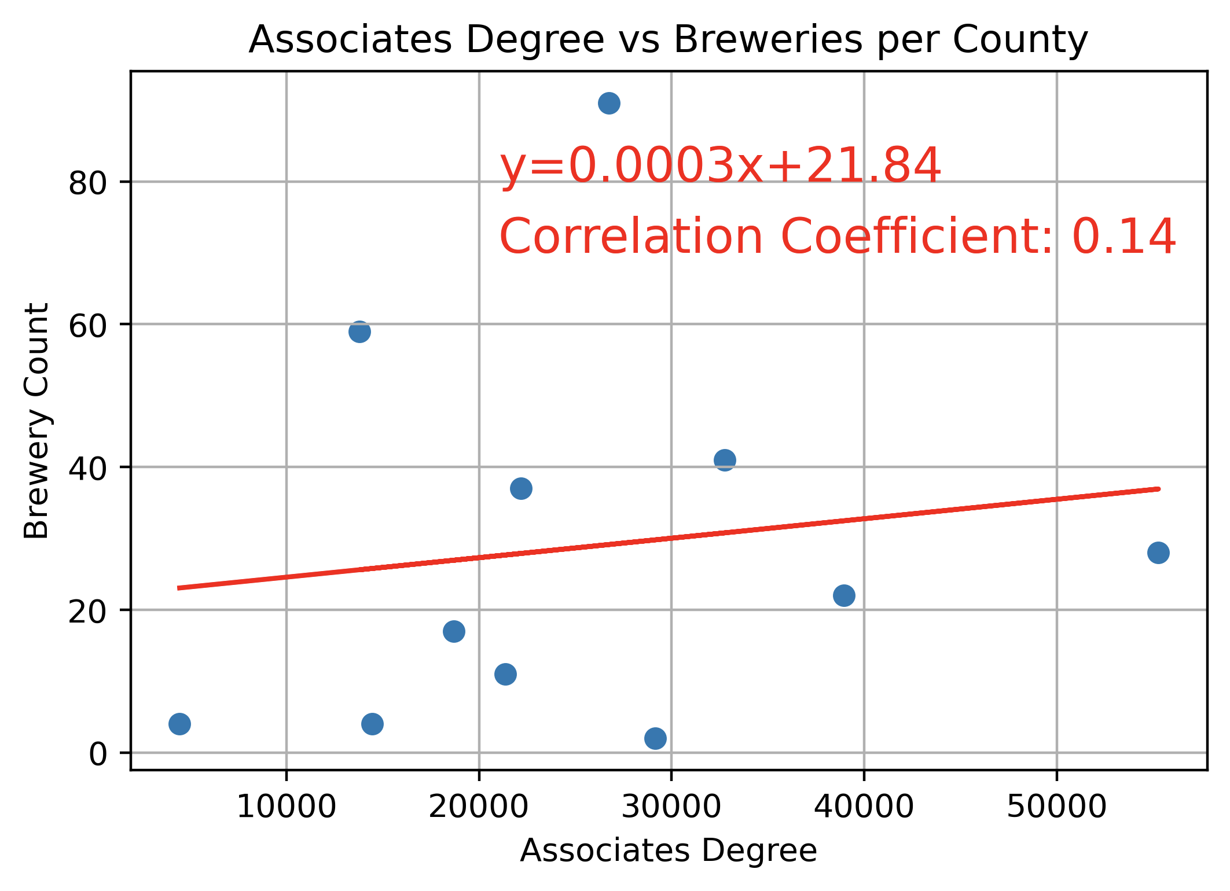
Brewery Count and Higher Education
The number of residents in the sample data set with high school and/or associate's degrees do not appear to have a direct influence on the number of breweries in the county.

Slide 18
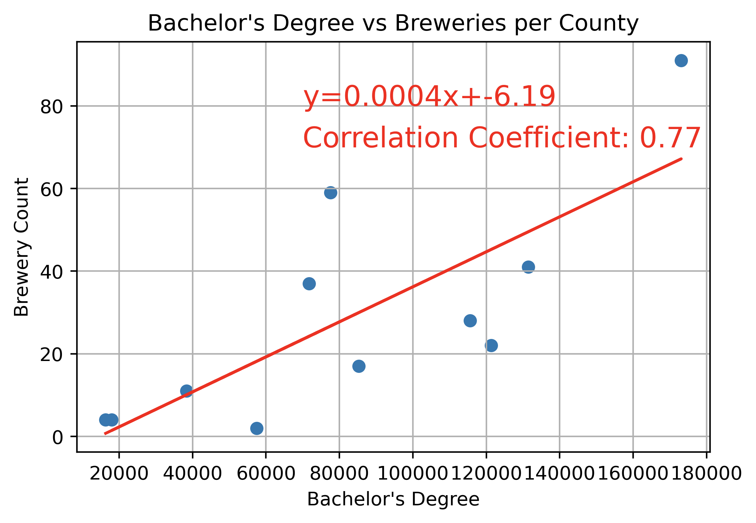
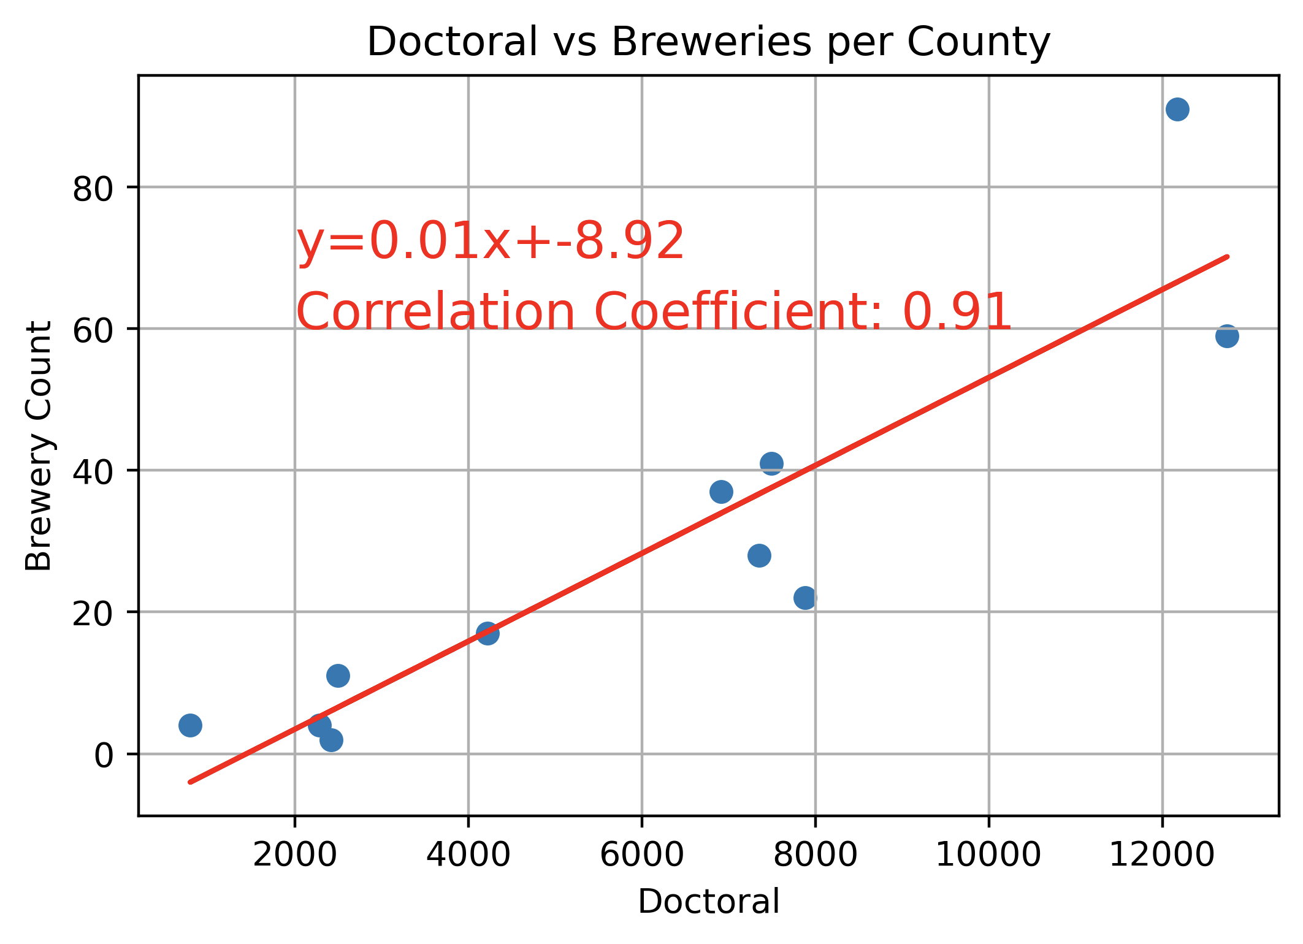
Brewery Count and Higher Education cont.
There does appear to be a strong correlation between a counties brewery count and the higher educational degrees.

Slide 19
Conclusions
Initial Thoughts:
We originally believed that total population and median household income would directly influence the number of breweries in a county.
Findings:
Based on the sample data set, counties with higher levels of education, specifically PhDs, have a strong correlation with the number of breweries within the county they reside.

Slide 20
Further Study For:
(unanswered questions)

